Slide 1
Minimum-Cost Spanning Tree
weighted connected undirected graph
spanning tree
cost of spanning tree is sum of edge costs
find spanning tree that has minimum cost

Slide 2
Example
8
10
14
1
3
5
7
7
12
6
3
2
4
2
4
6
8
9
Network has 10 edges.
Spanning tree has only n - 1 = 7 edges.
Need to either select 7 edges or discard 3.

Slide 3
Edge Selection Greedy Strategies
Start with an n vertex forest. Consider edges in ascending order of cost. Select edge if it does not form a cycle together with already selected edges.
  Kruskal’s method.
Start with a 1 vertex tree and grow it into an n vertex tree by repeatedly adding a vertex and an edge. When there is a choice, add a least cost edge.
  Prim’s method.

Slide 4
Edge Selection Greedy Strategies
Start with an n vertex forest. Each component selects a least cost edge to connect to another component. Eliminate duplicate selections and possible cycles. Repeat until only 1 component is left.
  Sollin’s method.

Slide 5
Edge Rejection Greedy Strategies
Start with the connected graph. Repeatedly find a cycle and eliminate the highest cost edge on this cycle. Stop when no cycles remain.
Consider edges in descending order of cost. Eliminate an edge provided this leaves behind a connected graph.

Slide 6
Kruskal’s Method
8
10
14
1
3
5
7
1
3
5
7
7
4
12
6
3
2
2
4
6
8
2
4
6
8
9
Start with a forest that has no edges.
Consider edges in ascending order of cost.
Edge (1,2) is considered first and added to the forest.

Slide 7
Kruskal’s Method
8
10
14
1
3
5
7
1
3
5
7
7
3
7
4
6
3
2
4
12
6
2
2
4
6
8
2
4
6
8
9
Edge (7,8) is considered next and added.
Edge (3,4) is considered next and added.
Edge (5,6) is considered next and added.
Edge (2,3) is considered next and added.
Edge (1,3) is considered next and rejected because it creates a cycle.

Slide 8
Kruskal’s Method
8
10
14
10
14
1
3
5
7
1
3
5
7
7
3
7
4
6
3
2
4
12
6
2
2
4
6
8
2
4
6
8
9
Edge (2,4) is considered next and rejected because it creates a cycle.
Edge (3,5) is considered next and added.
Edge (3,6) is considered next and rejected.
Edge (5,7) is considered next and added.

Slide 9
Kruskal’s Method
8
10
14
10
14
1
3
5
7
1
3
5
7
7
3
7
4
6
3
2
4
12
6
2
2
4
6
8
2
4
6
8
9
n - 1 edges have been selected and no cycle formed.
So we must have a spanning tree.
Cost is 46.
Min-cost spanning tree is unique when all edge costs are different.

Slide 10
Prim’s Method
8
10
14
10
14
1
3
5
7
1
3
5
7
7
3
7
4
6
3
2
4
12
6
2
2
4
6
8
2
4
6
8
9
Start with any single vertex tree.
Get a 2 vertex tree by adding a cheapest edge.
Get a 3 vertex tree by adding a cheapest edge.
Grow the tree one edge at a time until the tree has n - 1 edges (and hence has all n vertices).

Slide 11
Sollin’s Method
8
10
14
1
3
5
7
1
3
5
7
7
12
6
3
4
6
3
2
4
2
2
4
6
8
2
4
6
8
9
Start with a forest that has no edges.
Each component selects a least cost edge with which to connect to another component.
Duplicate selections are eliminated.
Cycles are possible when the graph has some edges that have the same cost.

Slide 12
Sollin’s Method
8
10
14
10
14
1
3
5
7
1
3
5
7
7
3
7
4
6
3
2
4
12
6
2
2
4
6
8
2
4
6
8
9
Each component that remains selects a least cost edge with which to connect to another component.
Beware of duplicate selections and cycles.

Slide 13
Greedy Minimum-Cost Spanning Tree Methods
Can prove that all result in a minimum-cost spanning tree.
Prim’s method is fastest.
  O(n²) using an implementation similar to that of Dijkstra’s shortest-path algorithm.
  O(e + n log n) using a Fibonacci heap.
Kruskal’s uses union-find trees to run in O(n + e log e) time.

Slide 14
Pseudocode For Kruskal’s Method
Start with an empty set T of edges.
while (E is not empty && |T| != n-1)
{
Let (u,v) be a least-cost edge in E.
E = E - {(u,v)}. // delete edge from E
if ((u,v) does not create a cycle in T)
Add edge (u,v) to T.
}
if (| T | == n-1) T is a min-cost spanning tree.
else Network has no spanning tree.

Slide 15
Data Structures For Kruskal’s Method
Edge set E.
Operations are:
  Is E empty?
  Select and remove a least-cost edge.
Use a min heap of edges.
  Initialize. O(e) time.
  Remove and return least-cost edge. O(log e) time.

Slide 16
Data Structures For Kruskal’s Method
Set of selected edges T.
Operations are:
  Does T have n - 1 edges?
  Does the addition of an edge (u, v) to T result in a cycle?
  Add an edge to T.

Slide 17
Data Structures For Kruskal’s Method
Use an array linear list for the edges of T.
  Does T have n - 1 edges?
    Check size of linear list. O(1) time.
  Does the addition of an edge (u, v) to T result in a cycle?
    Not easy.
  Add an edge to T.
    Add at right end of linear list. O(1) time.
Just use an array rather than ArrayLinearList.

Slide 18
Data Structures For Kruskal’s Method
Does the addition of an edge (u, v) to T result in a cycle?
1
3
5
7
7
4
6
3
2
2
4
6
8
Each component of T is a tree.
When u and v are in the same component, the addition of the edge (u,v) creates a cycle.
When u and v are in the different components, the addition of the edge (u,v) does not create a cycle.

Slide 19
Data Structures For Kruskal’s Method
1
3
5
7
7
4
6
3
2
2
4
6
8
Each component of T is defined by the vertices in the component.
Represent each component as a set of vertices.
  {1, 2, 3, 4}, {5, 6}, {7, 8}
Two vertices are in the same component iff they are in the same set of vertices.

Slide 20
Data Structures For Kruskal’s Method
1
3
5
7
7
4
6
3
2
2
4
6
8
When an edge (u, v) is added to T, the two components that have vertices u and v combine to become a single component.
In our set representation of components, the set that has vertex u and the set that has vertex v are united.
  {1, 2, 3, 4} + {5, 6} => {1, 2, 3, 4, 5, 6}

Slide 21
Data Structures For Kruskal’s Method
Initially, T is empty.
1
3
5
7
2
4
6
8
Initial sets are:
  {1} {2} {3} {4} {5} {6} {7} {8}
Does the addition of an edge (u, v) to T result in a cycle? If not, add edge to T.
s1 = find(u); s2 = find(v);
if (s1 != s2) union(s1, s2);

Slide 22
Data Structures For Kruskal’s Method
Use FastUnionFind.
Initialize.
  O(n) time.
At most 2e finds and n-1 unions.
  Very close to O(n + e).
Min heap operations to get edges in increasing order of cost take O(e log e).
Overall complexity of Kruskal’s method is O(n + e log e).

Slide 23
Correctness of Kruskal’s Method
Must establish:
  Kruskal’s method results in a spanning tree whenever a spanning tree exists
  the spanning tree generated is of minimum cost.
Proof that method results in a spanning tree.
  Let G be any weighted undirected graph.
  From earlier know that an undirected graph G has a spanning tree iff it is connected.
  Only edges rejected in Kruskal’s method are those that are currently on a cycle.

Slide 24
Correctness of Kruskal’s Method
Proof continued.
  The deletion of a single edge that is on a cycle of a connected graph results in a graph that is also connected.
  Thus, if G is initially connected, the set of edges in T and E always forms a connected graph.
  Therefore method cannot terminate with E=φ and |T| < n - 1.

Slide 25
Correctness of Kruskal’s Method
Proof that the constructed spanning tree is of minimum cost.
  G has a finite number of spanning trees, so it has one of least cost.
  Let minTrees be the set of minimum-cost spanning trees of G.
  For any W ε minTrees, let d_{w} be the number of edges in T that are also in W.
  Let k, k < n be max{d_{w} | W ε minTrees}
  if k = n - 1, T ε minTrees so assume k < n - 1

Slide 26
Correctness of Kruskal’s Method
Proof by contradiction.
  See textbook.

Slide 27
Topological Sorting
Can represent a complex project as a collection of simplier tasks..
  Example: assemble an automobile.
  place chassis on assembly line
  mount axles
  mount wheels onto axles
  fit seats onto chassis
  paint
  install brakes
  etc.

Slide 28
Topological Sorting
  Precedence relationships exist between tasks.
    Chassis must be put onto assembly line before can mount axles, etc.
  Can represent precedence as a digraph.
    called an activity on vertex (AOV) network
    vertices represent tasks
    directed edge (i,j) represents that task i must be complete before task j can start.

Slide 29
Topological Sorting
1
3
4
6
2
5
Edge (1,4) implies that task 1 is to be done before task 4.
Edge (4,6) implies that task 4 is to be done before task 6
Thus task 1 must be done before task 6.

Slide 30
Topological Sorting
  Sometimes must perform the tasks consecutively.
  In this case, need a sequence with the property that for every edge (i,j) in the task digraph for the project, task i comes before task j in the assembly sequence.
  Such a sequence called a topological order or a topological sequence.
  Process of constructing a topological order from a task digraph is topological sorting.

Slide 31
Topological Sorting
1
3
4
6
2
5
123456 is a topological order.
132456 is a topological order
215346 is a topological order.
142356 is NOT a topological
order

Slide 32
Topological Sorting: Greedy Solution
Construct a sequence from left to right in stages
In each stage add a vertex to the sequence
To select, use the greedy criterion:
  From the remaining vertices, select a vertex w that has no incoming edge (v,w) with the property that v hasn’t already been placed into the sequence.
If no vertex meets this criterion, then sort fails.

Slide 33
Topological Sorting: Algorithm
Let n be the number of vertices in the digraph
Let theOrder be an empty sequence.
while (true)
{ Let w be any vertex that has no incoming edge (v,w) such that v is not in theOrder
if there is no such w, break
Add w to the end of theOrder
}
if (theOrder has fewer than n vertices)
the algorithm fails
else
theOrderis a topological sequence

Slide 34
Topological Sorting: Correctness
Must show
  that when algorithm fails, the digraph has no topological sequence
  when the algorithm doesn’t fail, theOrder is a topological sequence.
Item 2 is a direct consequence of the greedy criterion
Item 1. Must show that when the algorithm fails, the digraph has a cycle.
If the digraph has a cycle q₁,q₂,….q_{k},q₁ there can be no topological order since q₁ must precede q₁

Slide 35
Topological Sorting: Correctness
Lemma 18.1 If the previous algorithm fails, the digraph has a cycle.
Proof. Upon failure |theOrder| < n and there are no candidates for inclusion.
  So there is at least one vertex q₁ that is not in theOrder.
  The digraph must contain an edge (q₂,q₁) where q₂ is not in theOrder; otherwise q₁ is a candidate for inclusion.
  Similarly, there must be an edge (q₃,q₂) such that q₃ is not in theOrder.
  If q₃ = q₁ then q₁q₂q₃ is a cycle.
  if q₃ != q₁, there must be a q₄ s.t. (q₄,q₃) is an edge and q₄ is not in theOrder.
  If q₄ is one of q₁,q₂,q₃ the the digraph has a cycle.
  Can continue argument since there are a finite # of edges will eventually discover a cycle.

Slide 36
Topological Sorting: DS
theOrder can be a 1-D array
Use a stack to keep track of all vertices that are candidates
Use a 1-D array named inDegree such that inDegree[j] is the number of vertices i for which (i,j) is an edge of the digraph and i is not a member of theOrder
    A vertex j becomes a candidate for inclusion in theOrder inDegree[j] becomes 0
initialize theOrder to empty and inDegree[j] to the in-degree of j
Each time add a vertex x, inDegree[j] decreases by 1 for all j adjacent from the added vertex x.

Slide 37
Topological Sorting
1
3
4
6
2
5
inDegree = [0, 0, 1, 3, 1, 3]
vertices 1 and 2 are candidates

Slide 38
Topological Sorting: DS
Start with vertices 1 and 2 on the stack
remove a vertex from the stac and add it to theOrder and reduce the in-degree of adjacent vertices
So remove 2 and add to theOrder.
theOrder[0] = 2
inDegree = [0,0,1,2,0,3]
Since inDegree[5] is now 0, add 5 to the stack.

Slide 39
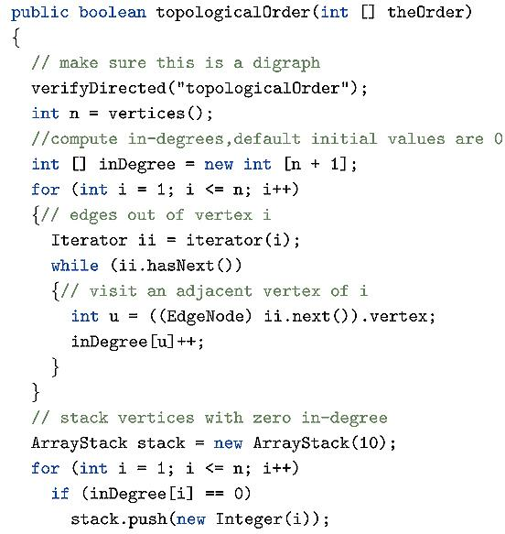
Topological Sorting

Slide 40
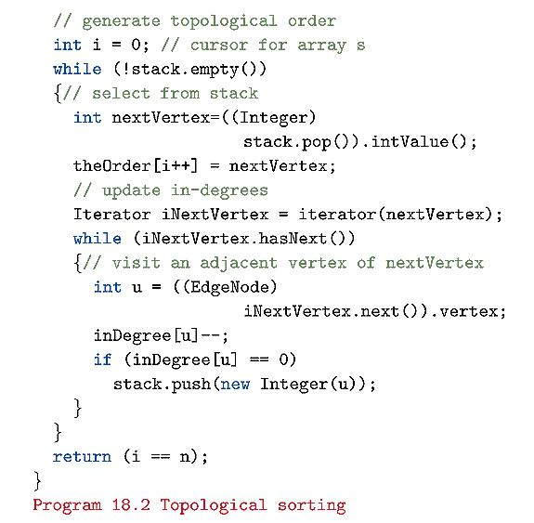
Topological Sorting

Slide 41
Topological Sorting: Complexity
Time in first for loop
  O(n²) if use adjacency-matrix
  O(n + e) is use linked-adjacency-list
Time in second for loop
  O(n)
Time in nested while loops
  outer at most n times
    Each iteration adds a vertex nextVertex to theOrder and initiates the inner while.
  if use adjacency matrices, inner while takes O(n) for each nextVertex
  When use adjacency lists, inner while takes O(d^{out}nextVertex)
  total time is thus either O(n²) or O(n+e)

Slide 42
Bipartite Cover
Bipartite Graph: an undirected graph in which the n vertices may be partitioned into two sets A and B so that no edge in the graph connects two vertices that are in the same set.
i.e., every edge in the graph has one endpoint in A and the other in B.

Slide 43
Bipartite Cover
A subset A’ of A is said to cover B iff every vertex in B is connected to at least one vertex in A’.
The size of the cover A’ is the number of vertices in A’.
A’ is a minimum cover iff A has no subset of smaller size that covers B.

Slide 44
Bipartite Cover
1
2
3
16
17
4
5
6
7
8
9
10
11
12
13
14
15
A = {1,2,3,16,17} B = {4,5,6,7,8,9,10,11,12,13,14,15}
A’ = {1,2,3,17} covers B and |A’| = 4
A’ = {1,16,17} also covers B and |A’|= 3
The latter is a minimum cover of B.

Slide 45
Bipartite Cover
bipartite cover problem: find the minimum cover in a bipartite graph.
Examples: identify the fewest number of interpreters who can handle the translations at the convention.
The bipartite cover problem can be reduced to the set-cover problem:
  Given a collection S={S₁, S₂, … S_{k}} of k sets whose members are from a universe U.
  A subset S’ of S covers U iff the union of j s.t. j is a member of some set in S’ is equal to U.
  The number of sets in S’ is the size of the cover.
  S’ is a minimum cover iff there is no cover of U smaller

Slide 46
Bipartite Cover
Can reduce the set-cover problem into the bipartite-cover problem by using the vertices in A to represent the sets in S and the vertices in B to represent the elements of U.
  an edge exists between a vertex in A and one in B iff the corresponding element of U is in the corresponding set of S.
The set-cover problem is NP-hard, so the bipartite cover problem is also NP-hard.
Can use greedy method to develop a fast heuristic.

Slide 47
Bipartite Cover
Construct the cover A’ in stages.
In each stage select a vertex of A for inclusion into the cover.
Select vertex with a greedy criterion:
Select a vertex of A that covers the largest number of uncovered vertices of B.

Slide 48
Bipartite Cover
1
2
3
16
17
4
5
6
7
8
9
10
11
12
13
14
15
A’ = { }. No vertex of B is covered.
Vertices 1 and 16 cover 6 uncovered vertices of B
Vertex 3 covers 5
Vertices 2 and 17 each covers four.
So choose either vertex 1 or 16. Say 16

Slide 49
Bipartite Cover
1
2
3
16
17
4
5
6
7
8
9
10
11
12
13
14
15
A’ = { 16}. Vertices {5,6,8,12,14,15} of B are covered.
Uncovered B vertices = {4,7,9,10,11,13}
Vertices of A: 1 covers 4 uncovered B vertices
  vertex 2 covers one, vertex 3 covers one, vertex 16 covers 0, vertex 17 covers 4
  Select either vertex 1 or 17. Say 1

Slide 50
Bipartite Cover
1
2
3
16
17
4
5
6
7
8
9
10
11
12
13
14
15
A’ = { 1,16}. Vertices {4, 5,6, 7, 8, 9, 12 ,13,14,15} of B are covered.
Uncovered B vertices = {10,11}
Vertices of A:
  vertices 2 covers 0, vertex 3 covers one, vertex 16 covers 0, vertex 17 covers 2
  Select vertex 17. No vertices of B remain uncovered.
A’ = {1, 16, 17}

Slide 51
Bipartite Cover
A’ = { }
while (more vertices can be covered)
Add the vertex that covers the largest number of uncovered verticies to A’
if (some vertices are uncovered) fail
else a cover has been found.

Slide 52
Bipartite Cover
The algorithm fails to find a cover iff the initial bipartite graph does not have a cover
bipartite graphs exist on which the heuristic will fail to find a minimum cover.

Slide 53
Bipartite Cover: DS
Store A’ as a 1-D array called theCover
variable coverSize keeps track of the number of elements in A’
new_{i} is the number of uncovered vertices of B that vertex i covers.
At each stage select the vertex with maximum new_{i}
then update the new_{i} of other vertices since some previously uncovered vertices are now covered .
  must examine the vertices of B that are newly covered
  Let j be a newly covered vertex of B.
  The new_{i} value of all vertices of A that cover j must be reduced by 1.

Slide 54
Bipartite Cover
1
2
3
16
17
4
5
6
7
8
9
10
11
12
13
14
15
initialize new:
new = [new₁, new₂, new₃, new₁₆, new₁₇] = [6,4,5,6,4]
Select either 1 or 16; say 16
Newly covered vertices: 5,6,8,12,14,15
examine vertex 5. Reduce new values of vertices 2,16
examine vertex 6. Reduce values of 1,2,16 etc.

Slide 55
Bipartite Cover
1
2
3
16
17
4
5
6
7
8
9
10
11
12
13
14
15
after examining all newly covered vertices get
new = [new₁, new₂, new₃, new₁₆, new₁₇] = [4,1,1,0,4]
Select either 1 or 17; say 1
Newly covered vertices: 4,7,9,13
examine vertex 4. Reduce new values of vertices 2,17
examine vertex 7. Reduce no values etc.

Slide 56
Bipartite Cover: DS
Vertex selection process. Need to know
  new values
  which vertices have been covered
Use 1-D array newVerticesCovered:
newVerticesCovered[i] = new_{i}
Use 1-D array covered
covered[i] = true if vertex i of B is covered
Algorithm: see next slide.

Slide 57
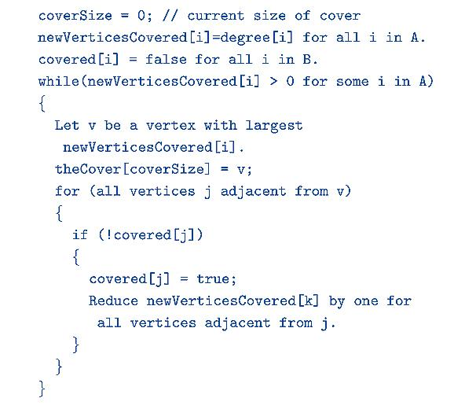
Bipartite Cover

Slide 58
Bipartite Cover: Complexity
To update newVerticesCovered: O(e)
To find the edges of a graph:
  O(n²) if using adjacency matrix
  O(n + e) if using adjacency list
So total update time is either O(n²) or O(n + e)
Selection of vertex v at start of each stage: θ(SizeofA) where SizeofA = |A|.
Overall complexity:
  O(SizeofA + n²) or
  O(SizeofA + n + e)

Slide 59
Bipartite Cover: Complexity
To reduce complexity of selecting vertex v
  Use sorted array of new_{i} valuses OR
  use a max heap OR
  use a max selection tree.

Slide 60
Bipartite Cover: Complexity
Max Heap
  Must restructure heap after each stage to account for change in newVerticesCovered values.
  So must restructure each time a newVerticesCovered value is reduced by 1.
  Will cause the reduced newVerticesCovered value to move at most one level down in the heap.
  So restructures costs θ(1) per newVerticesCovered reduction of 1
  Total number of reductions is O(e).
  Over all stages of the algorithm, only O(e) time is spent maintaining the max heap.
Total time for the algorithm: O(n²) or O(n + e)

